Slide 1

IronKaggle
King County Housing Data Exploration
Team: Sergei, Frank, Bosco

Slide 2
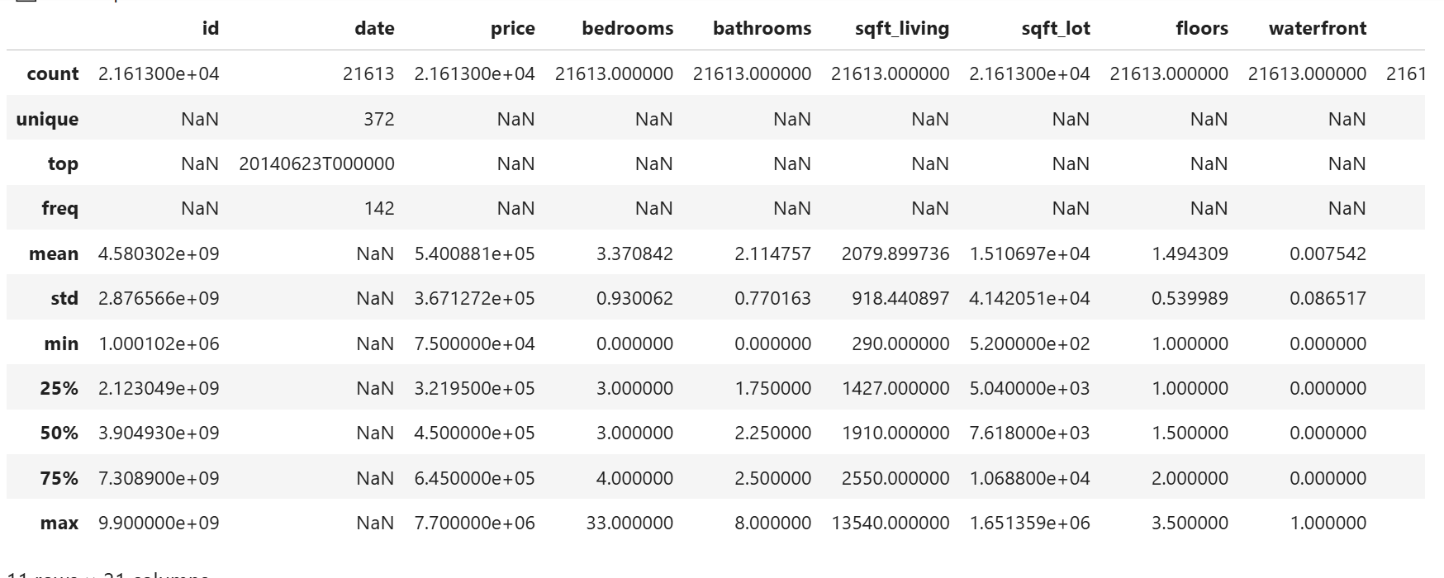
Descriptive Statistics:
The dataset contains a total of 21,613 house sales records and 21 attributes
House prices range from $75,000 to $7.7 million
Average price of $540,000, reflecting a wide range of property values across different neighborhoods
High standard deviations in features such as price and sqft_lot

Slide 3

Data Inspection & Cleaning
The dataset shows no missing or duplicate record
The 'date' column converted to datetime
Numeric columns Converted to numeric data types
The 'zipcode' feature converted to string type (Categorical)
Summary
After the data cleaning and type casting process, the dataset remains complete with 21,613 records and 21 columns, confirming that no entries were lost or altered

Slide 4
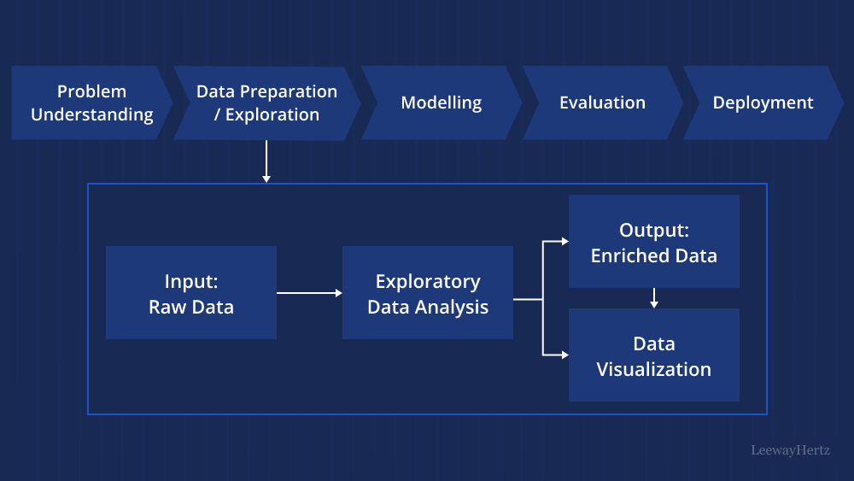
Exploratory Data Analysis

Slide 5
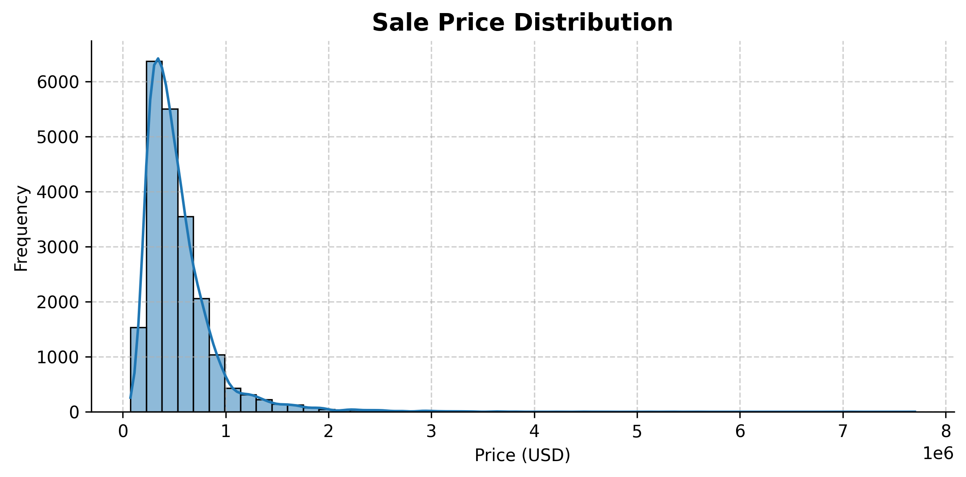
Sales Price Analysis
Findings
It reveals a right-skewed pattern
The majority of sales fall below $1 million
This skewness suggests the presence of outliers and implies that applying a logarithmic transformation to the price variable could help normalize the data

Slide 6
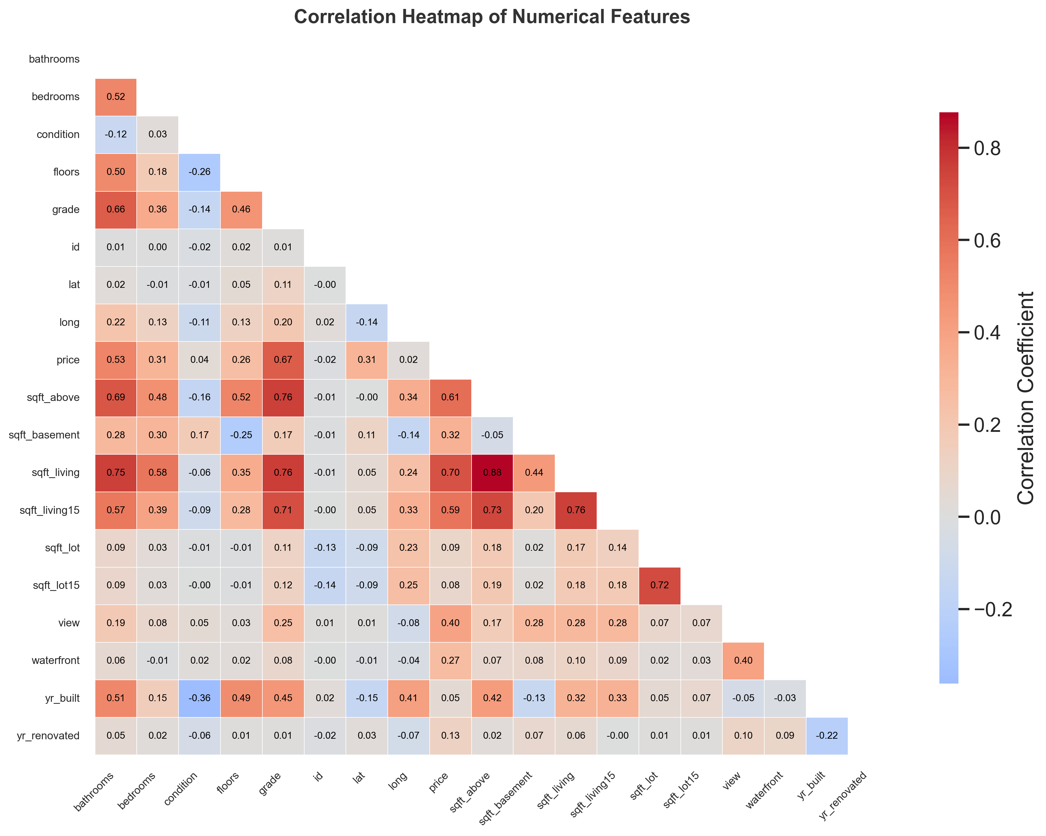
Bivariate analysis
The sale price shows strong positive correlations with key variables, including grade (0.67) and sqft_living (0.70)
The sqft_living, sqft_above, and sqft_living15 have correlation coefficients above 0.75, highlighting instances of multicollinearity
Features like id, longitude (long), sqft_lot, sqft_lot15, and yr_renovated show very weak correlations with sale price, bathrooms (0.52), sqft_above (0.60), view (0.40), and waterfront

Slide 7
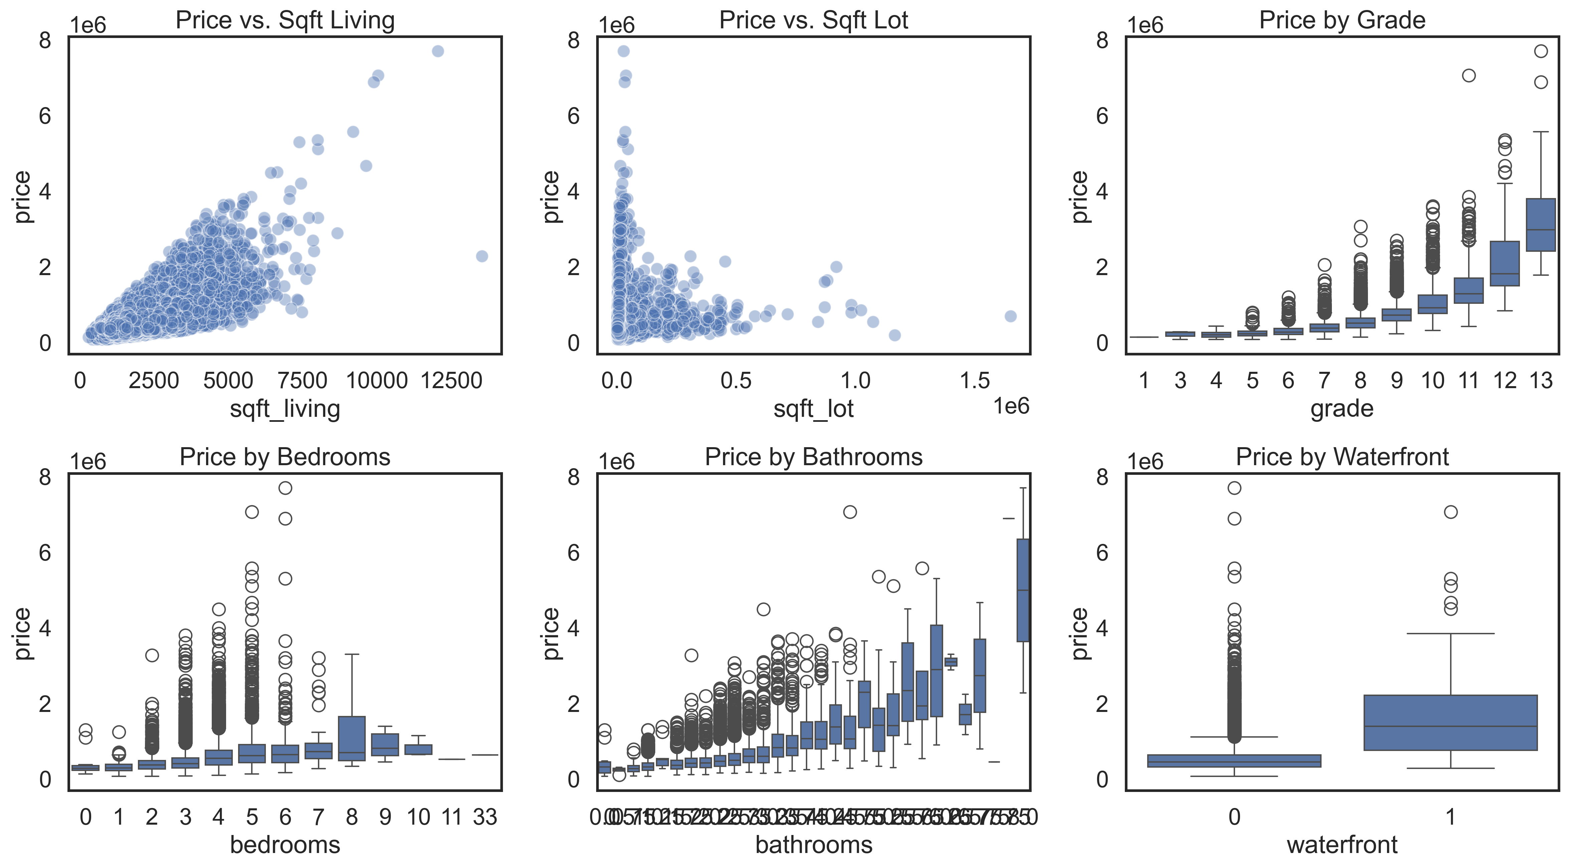
Key Relationship

Slide 8
Feature Selection Insight
Retain: sqft_living, grade, bathrooms, and waterfront (they show strong influence on price)
Dropping sqft_lot and bedrooms, as they provide weaker or less consistent predictive value

Slide 9
Feature Engineering
Extracting Date Components
Creating size ratio features (sqft_living_per_room, lot_to_living_ratio, has_basement)
Neighborhood Proxy Features (living15_ratio, lot15_ratio)
Transformations for Skewed Variables

Slide 10
BASELINE MODEL PERFORMANCE
Linear Regression
R² Score: 0.7012
RMSE: 212,539.52
Mean Squared Error: 45,173,046,132.79

Slide 11
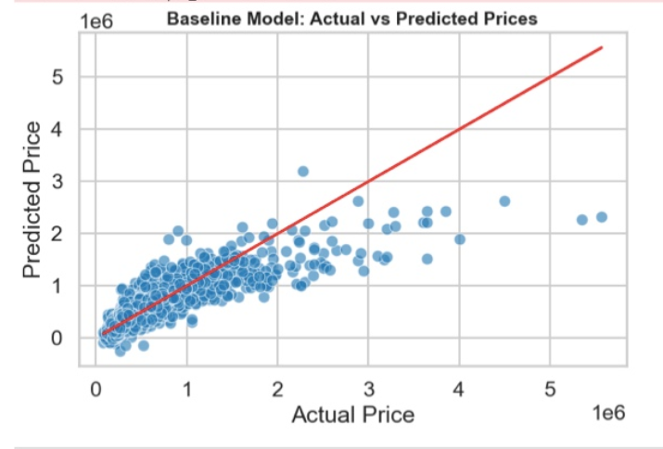
Actual vs Predicted Prices

Slide 12
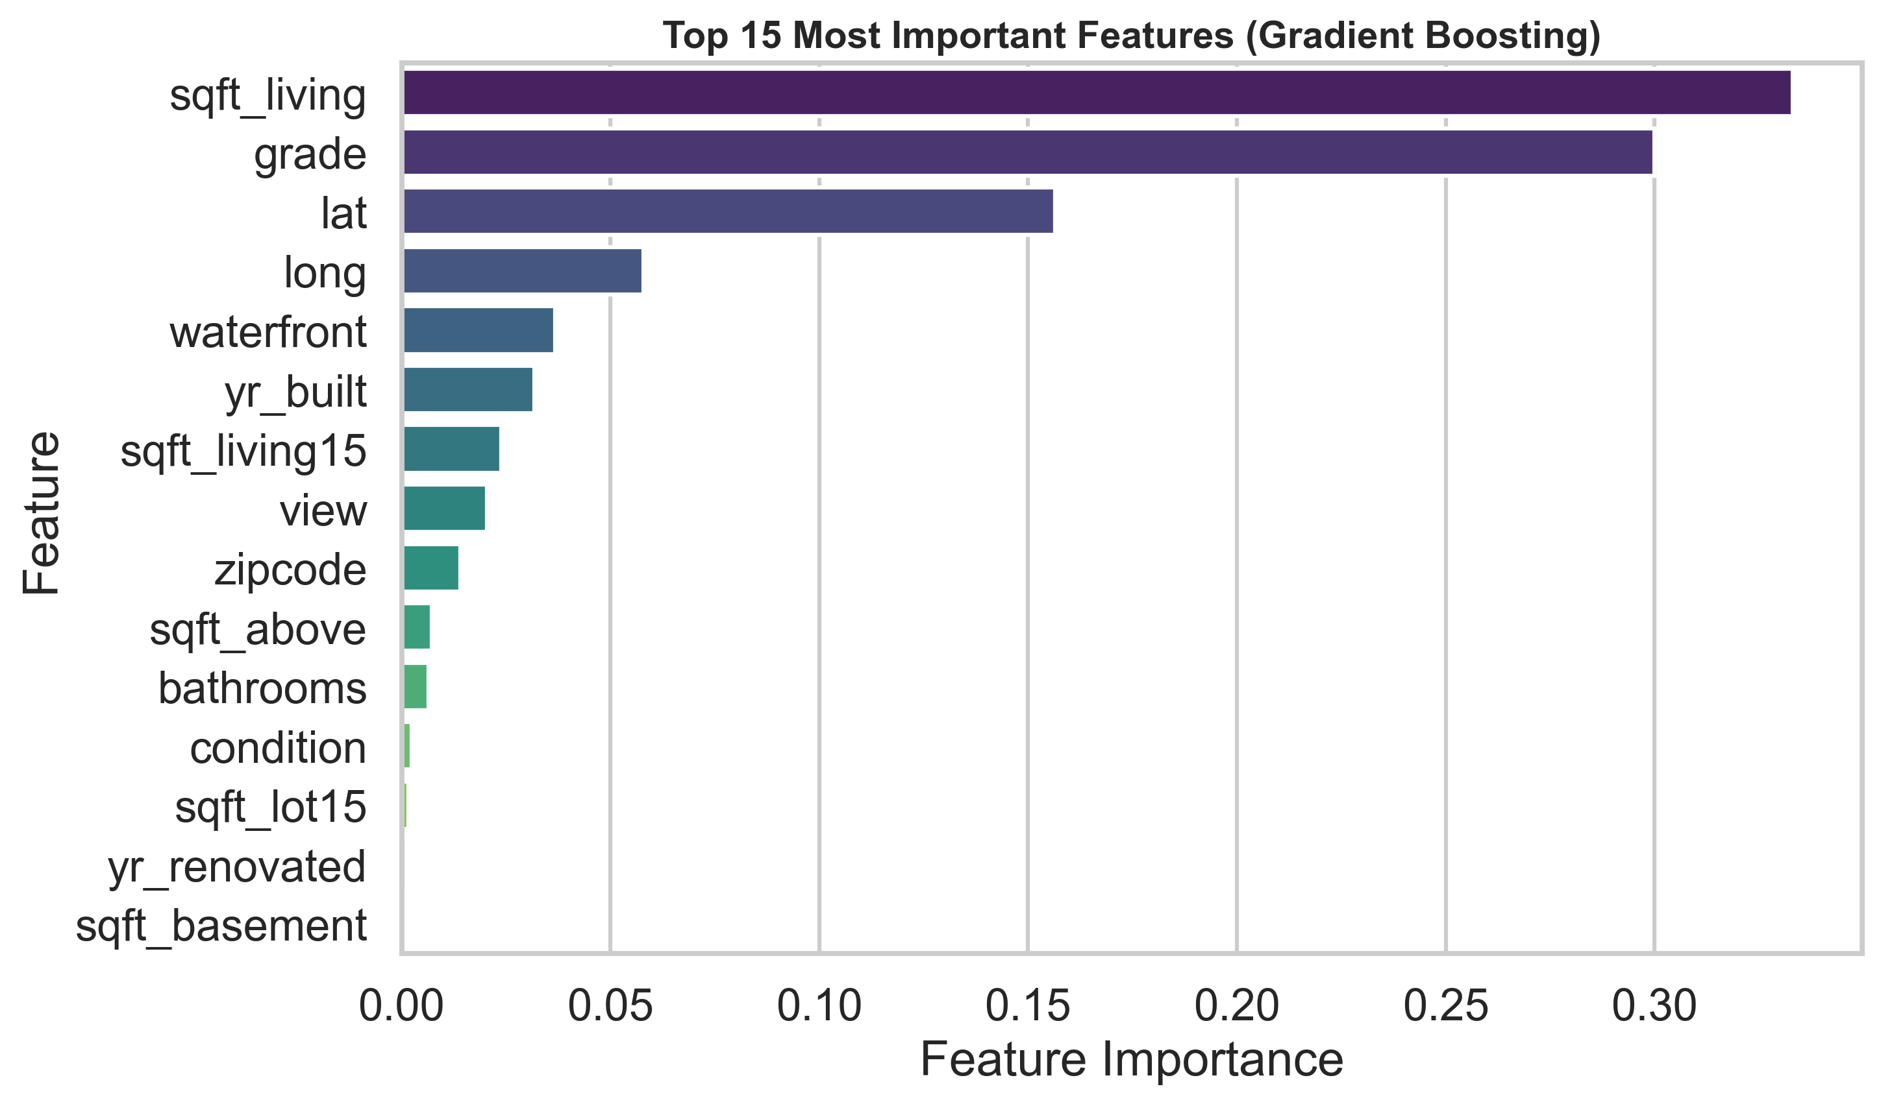
Important Features

Slide 13
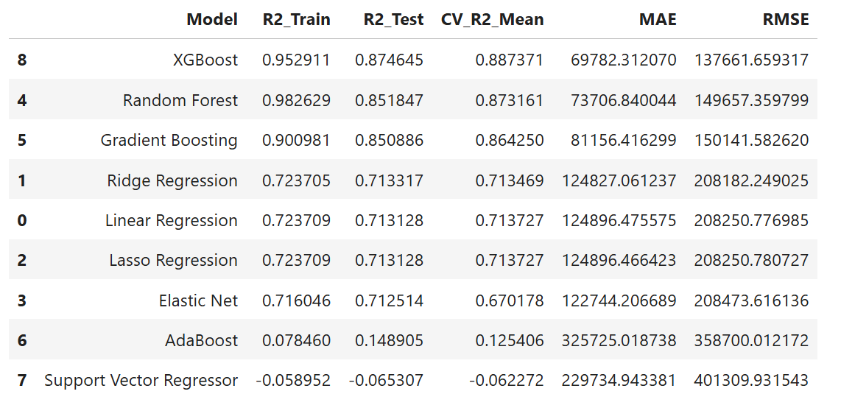
Model Training, Evaluation, and Performance Comparison

Slide 14
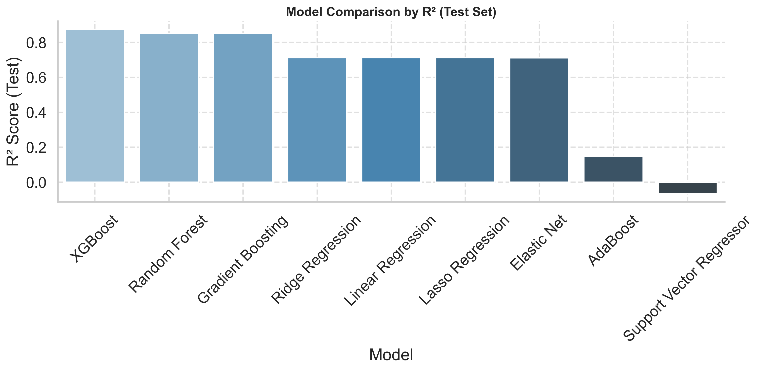
Model Training, Evaluation, and Performance Comparison

Slide 15
Summary & Conclusion
XGBoost achieved the highest test R² (0.8746) and lowest error metrics, indicating excellent accuracy and strong generalization to unseen data.
Random Forest and Gradient Boosting followed closely, both explaining over 85% of variance in housing prices with stable cross-validation scores
Linear models (Ridge, Lasso, Linear Regression, Elastic Net) showed moderate performance (~0.71 R²)

Slide 16
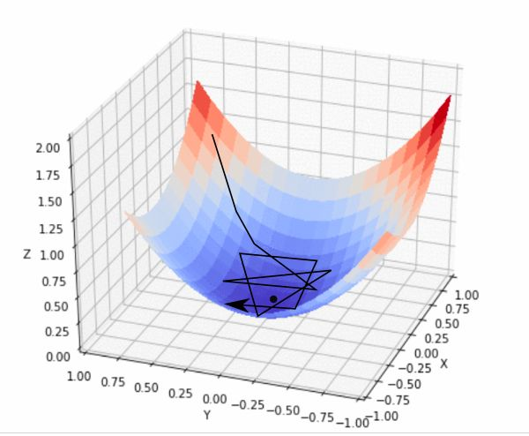
Best Model - XGBoost Regressor
Superior balance of bias
Excellent predictive power and robustness
Handles feature interactions and nonlinear relationships efficiently
Scalable and well-suited for production deployment

